Slide 1

Online Sales Dataset - Popular Marketplace Data
Agata Gera

Slide 2
Project Overview
The primary goal of this project is to analyze and gain insights from sales data to enhance business decision-making processes. The analysis focuses on several key areas including sales trends, product popularity, payment methods, and regional performance. The findings may help tailor marketing strategies and optimize product offerings.

Slide 3
Source:
https://www.kaggle.com/datasets/shreyanshverma27/online-sales-dataset-popular-marketplace-data

Slide 4
About Dataset
Order ID: Unique identifier for each sales order.
Date: Date of the sales transaction.
Category: Broad category of the product sold (e.g., Electronics, Home Appliances, Clothing, Books, Beauty Products, Sports).
Product Name: Specific name or model of the product sold.
Quantity: Number of units of the product sold in the transaction.
Unit Price: Price of one unit of the product.
Total Price: Total revenue generated from the sales transaction (Quantity * Unit Price).
Region: Geographic region where the transaction occurred (e.g., North America, Europe, Asia).
Payment Method: Method used for payment (e.g., Credit Card, PayPal, Debit Card).

Slide 5
Analysis
1. Analyze sales trends over time to identify seasonal patterns
2. Explore the popularity of different product categories across regions.
3. Investigate the impact of payment methods on sales volume or revenue.
4. Identify top-selling products within each category
5. Evaluate the performance of specific products or categories in different regions to tailor marketing campaigns accordingly

Slide 6
Change in the dataset
A new column date_sale has been added and the insert from the Date column has been converted from TEXT to DATE.
Column Date has been dropped.
Date_month column has been addes.

Slide 7





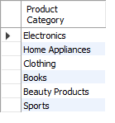


Time period
Regions
Product Category
Payment Method

Slide 8
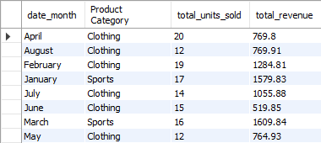
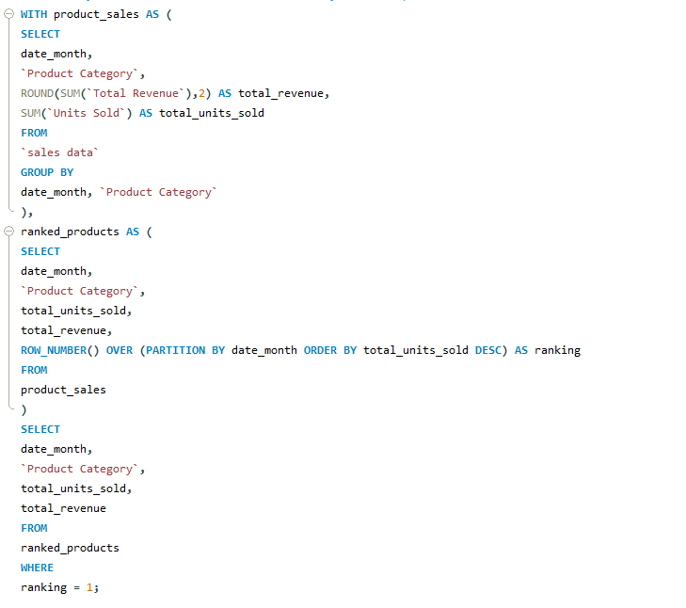
1. Analyze sales trends over time to identify seasonal patterns
For most months, the best-selling product
Category is clothing with th exception of
Months: January and March, where category
sport is the best-seler.

Slide 9
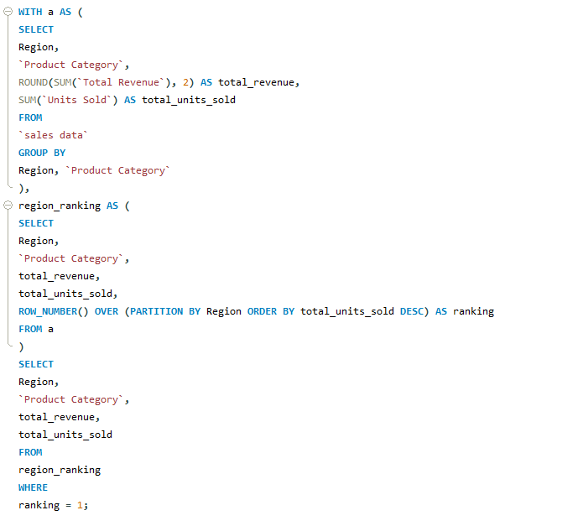

2. Explore the popularity of different product categories across regions.
The most popular product for each regions :

Slide 10
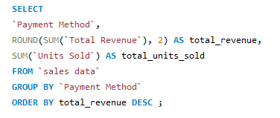

3. Investigate the impact of payment methods on sales volume or revenue.
Largest impact on revenue and sales volume
from credit cards.

Slide 11
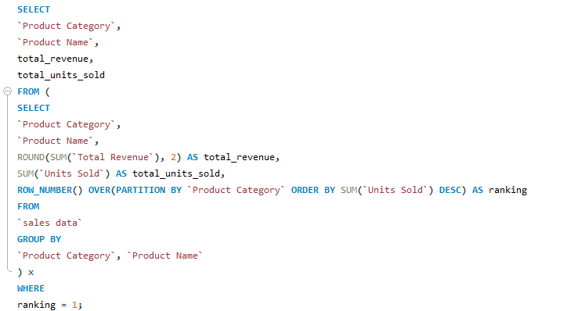
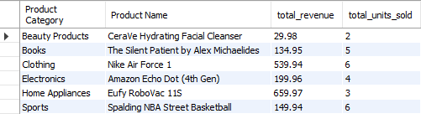
4. Identify top-selling products within each category

Slide 12
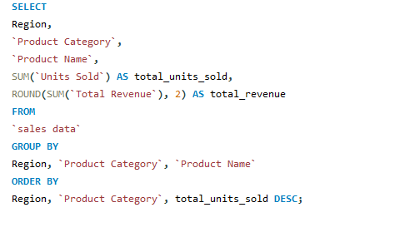
5. Evaluate the performance of specific products or categories in different regions to tailor marketing campaigns accordingly.
[There is only code because the output table is too long to present here.]

Slide 13
Conclusions:
For most months, the best-selling product Category is clothing with th exception of months: January and March, where category sport is the best-seler.
Largest impact on revenue and sales volume from credit cards.
The most popular product for each region: clothing for Asia, home appliances for Europe, electronics for North America
Top-selling products within each category:

Slide 14
Recommendations Based on Analysis:
Optimize Inventory and Marketing for Clothing Category
Special Promotions for Sports Category in January and March
Leverage Credit Card Payment Preferences e.g.: introduce incentives for using credit cards, such as cashback offers, reward points, or discounts on credit card payments. Collaborate with credit card companies to create co-branded promotions.

